Slide 1
The Ruby Programming Language
-Vishal Mishra

Slide 2
Ruby Installation
Ruby Versions
Devkit
Machine Setup
RubyMine : IDE
Gem Introduction
Windows
Navigate to: http://www.ruby-lang.org/en/downloads/
Scroll down to "Ruby on Windows"
Download the "One-click Installer"
Follow the install instructions
Include RubyGems if possible (this will be necessary for Rails installation later)
Mac/Linux
Probably already on your computer
OS X 10.4 ships with broken Ruby! Go here…
http://hivelogic.com/articles/view/ruby-rails-mongrel-mysql-osx

Slide 3
Interpreted Languages
Not compiled like Java
Code is written and then directly executed by an interpreter
Type commands into interpreter and see immediate results
Java:
Code
Compiler
Runtime
Environment
Computer
Ruby:
Code
Interpreter
Computer

Slide 4
Object Orientation
Everything is object
Ruby is fully object oriented; everything is an object.
Inheritance is shown by ‘<‘ instead of ‘extends’.
Java: class Student extends Person
Ruby: class Student < Person
Modules are used to group classes
class Person < ActiveRecord:: Base
Modules are like namespaces in html and xml.
Access controls are similar to Java: public, protected and private. Each controls everything following it in a class.
All variables are accessed by reference.

Slide 5
Conventions
Class names begin with upper case letters.
Method and variable names use lower case.
For names with more than one word:
Class names use camel (or bumpy) case
class ActiveRecord
Method and variable names separate words with underscores.
def show_person
@little_girl
In Rails, table names are the plurals of the record names
Single record is course
Table is called courses
But the model class is called Course.

Slide 6
Comments
# this is a single line comment
=begin
this is a multiline comment
nothing in here will be part of the code
=end

Slide 7
Variables and Symbols
Ruby is weakly typed. Variables receive their types during assignment.
There is no boolean type, but everything has a value. False and nil are false and all other objects are true.
Instance variables (class variables) begin with the ‘@’ sign.
@name, @age, @course
Global variables begin with two ‘@’ signs. They are almost never used.
Symbols seem to be peculiar to Ruby. They begin with a colon.
:name, :age, :course
Symbols have a name (string) and value (integer) but no location.

Slide 8
Variables
Declaration – No need to declare a "type"
Assignment – same as in Java
Example:
x = "hello world" # String
y = 3 # Fixnum
z = 4.5 # Float
r = 1..10 # Range

Slide 9
Objects
Everything is an object.
Common Types (Classes): Numbers, Strings, Ranges
nil, Ruby's equivalent of null is also an object
Uses "dot-notation" like Java objects
You can find the class of any variable
x = "hello"
x.class → String
You can find the methods of any variable or class
x = "hello"
x.methods
String.methods

Slide 10
Objects (cont.)
There are many methods that all Objects have
Include the "?" in the method names, it is a Ruby naming convention for boolean methods
nil?
eql?/equal?
==, !=, ===
instance_of?
is_a?
to_s

Slide 11
Blocks
If a block consists of a single line, it is enclosed in curly braces.
Usually blocks begin with a control statement and are terminated with the keyword, ‘end’.
Indentation, usually two spaces, is used to indicate what is in the block. Common errors are to have either too few or too many ‘ends’.
Variables within a block are local to the block unless they are instance variables starting with the ‘@’ sign.
Methods begin with the keyword, ‘def’, and are terminated with an ‘end’.
Parameters are enclosed with parentheses. If a method has no parameters, the parentheses are optional.

Slide 12
Numbers
Numbers are objects
Different Classes of Numbers
FixNum, Float
3.eql?2 → false
-42.abs → 42
3.4.round → 3
3.6.rount → 4
3.2.ceil → 4
3.8.floor → 3
3.zero? → false

Slide 13
String Methods
"hello world".length → 11
"hello world".nil? → false
"".nil? → false
"ryan" > "kelly" → true
"hello_world!".instance_of?String → true
"hello" * 3 → "hellohellohello"
"hello" + " world" → "hello world"
"hello world".index("w") → 6

Slide 14
Operators and Logic
Same as Java
Multiplication, division, addition, subtraction, etc.
Also same as Java AND Python (WHA?!)
"and" and "or" as well as "&&" and "||"
Strange things happen with Strings
String concatenation (+)
String multiplication (*)
Case and Point: There are many ways to solve a problem in Ruby

Slide 15
if/elsif/else/end
Must use "elsif" instead of "else if"
Notice use of "end". It replaces closing curly braces in Java
Example:
if (age < 35)
puts "young whipper-snapper"
elsif (age < 105)
puts "80 is the new 30!"
else
puts "wow… gratz..."
end

Slide 16
Inline "if" statements
Original if-statement
if age < 105
puts "don't worry, you are still young"
end
Inline if-statement
puts "don't worry, you are still young" if age < 105

Slide 17
for-loops
for-loops can use ranges
Example 1:
for i in 1..10
puts i
end
Can also use blocks (covered next week)
3.times do
puts "Ryan! "
end

Slide 18
for-loops and ranges
You may need a more advanced range for your for-loop
Bounds of a range can be expressions
Example:
for i in 1..(2*5)
puts i
end

Slide 19
while-loops
Can also use blocks (next week)
Cannot use "i++"
Example:
i = 0
while i < 5
puts i
i = i + 1
end

Slide 20
unless
"unless" is the logical opposite of "if"
Example:
unless (age >= 105) # if (age < 105)
puts "young."
else
puts "old."
end

Slide 21
until
Similarly, "until" is the logical opposite of "while"
Can specify a condition to have the loop stop (instead of continuing)
Example
i = 0
until (i >= 5) # while (i < 5), parenthesis not required
puts I
i = i + 1
end

Slide 22
Methods
Structure
def method_name( parameter1, parameter2, …)
statements
end
Simple Example:
def print_ryan
puts "Ryan"
end

Slide 23
Parameters
No class/type required, just name them!
Example:
def cumulative_sum(num1, num2)
sum = 0
for i in num1..num2
sum = sum + i
end
return sum
end
# call the method and print the result
puts(cumulative_sum(1,5))

Slide 24
Return
Ruby methods return the value of the last statement in the method, so…
def add(num1, num2)
sum = num1 + num2
return sum
end
can become
def add(num1, num2)
num1 + num2
end

Slide 25
User Input
"gets" method obtains input from a user
Example
name = gets
puts "hello " + name + "!"
Use chomp to get rid of the extra line
puts "hello" + name.chomp + "!"
chomp removes trailing new lines

Slide 26
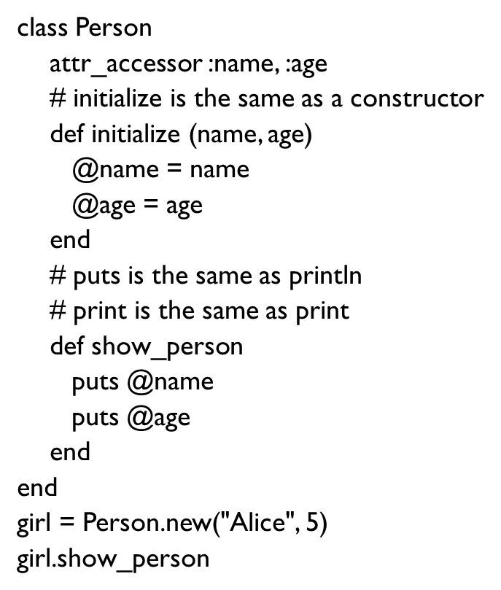
Example Program - Ruby

Slide 27
Instantiation and Initialization
Ruby has girl = Person.new(“Alice”, 5).
Java has Person girl = new Person(“Alice”,5);
Java comments begin with ‘//’; Ruby’s with ‘#’.
In Ruby we can write
attr_accessor :name, :age
instead of getters and setters.
String getName () { }
void setName (String name) { }

Slide 28
Data Structures
Arrays
Indexed with integers starting at 0.
Contents do not have to all be the same type.
Contents can be assigned in a list using square brackets.
order = [“blue”, 6, 24.95]
Arrays are objects so must be instantiated with ‘new’.
Hash Tables
Key – value pairs
Keys are almost always symbols
Contents can be assigned in a list of key-value pairs using curly braces.
order = {:color => “blue”, :size => 6, :price => 24.95}
To retrieve an element, use square brackets
@size = order[:size]

Slide 29
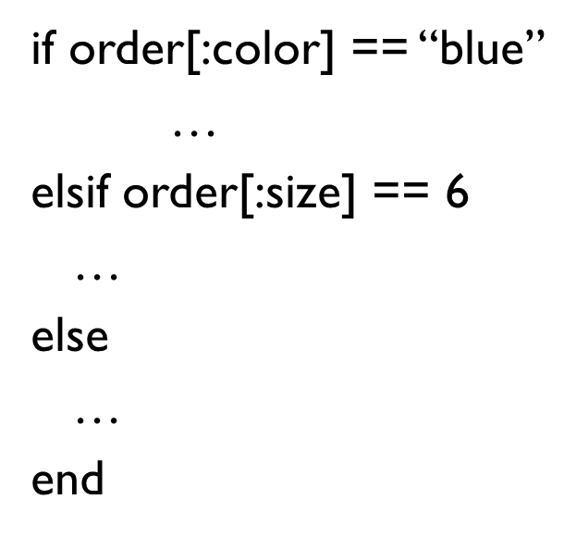
Control Structures: Conditionals

Slide 30
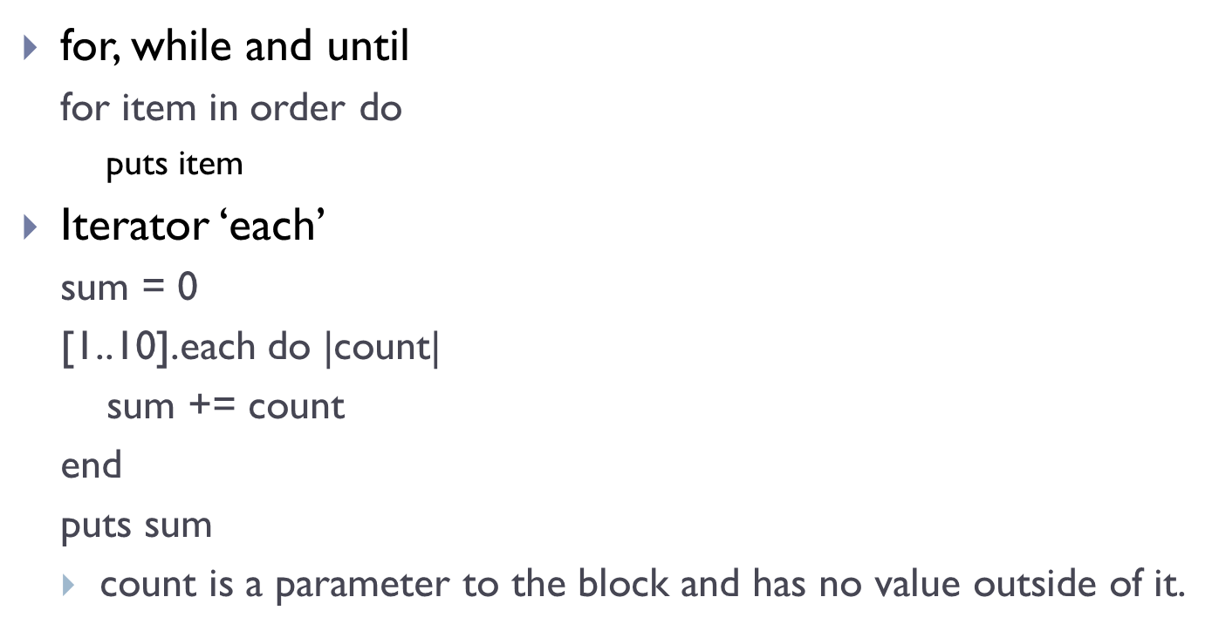
Control Structures: Iteration

Slide 31
Week 1 Assignment
Ruby Simple programs for practicing raw ruby
Hello world
Print Integer
Addition
Odd or Even
Add, subtract, multiply and divide
Check vowel
Leap year
Add digits
Factorial
HCF and LCM
Decimal to binary conversion
ncR and nPr
Add n numbers
Swapping
Reverse number
Palindrome number
Print Pattern
Diamond
Prime numbers
Find armstrong number
Generate armstrong number
Fibonacci series
Addition using pointers
Maximum element in array
Minimum element in array
Linear search
Binary search
Reverse array
Insert element in array
Delete element from array
Merge arrays
Bubble sort
Insertion sort
Selection sort
Add matrices
Subtract matrices
Transpose matrix
Multiply two matrices
Print string
String length
Compare strings
Copy string
Concatenate strings
Reverse string
Find palindrome
String to integer
Delete vowels
C substring
Sort a string
Remove spaces
Change case
Swap strings
Character's frequency
Anagrams
Read file
Copy files
Merge two files
List files in a directory
Delete file
Random numbers
Add complex numbers
Print date
Get IP address
Shutdown computer

Slide 32
References
Web Sites
http://www.ruby-lang.org/en/
http://rubyonrails.org/
Books
Programming Ruby: The Pragmatic Programmers' Guide (http://www.rubycentral.com/book/)
Agile Web Development with Rails
Rails Recipes
Advanced Rails Recipes

